Slide 1
The Future is Now!
APA Strategic Plan

Slide 2

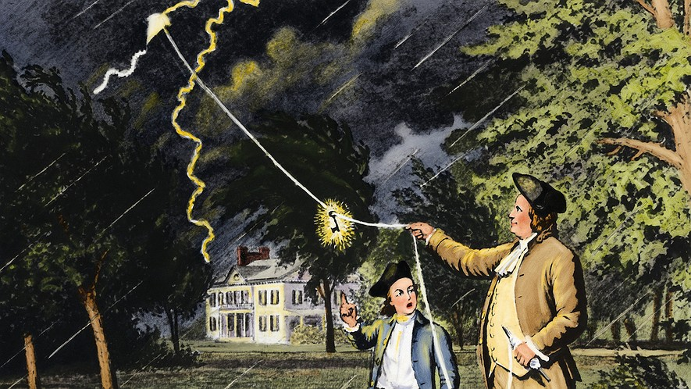
History of the discovery of electricity
600 B.C. – Thales of Miletus writes about amber becoming charged by rubbing.
1752 A.D. – Ben Franklin performed his famous kite-flying experiment
Notes:
1600 A.D. – English scientist William Gilbert coins the term electricity from the Greek word for amber. Experiments with magnets, coining the terms electric force, magnetic pole, and electric attraction.

Slide 3
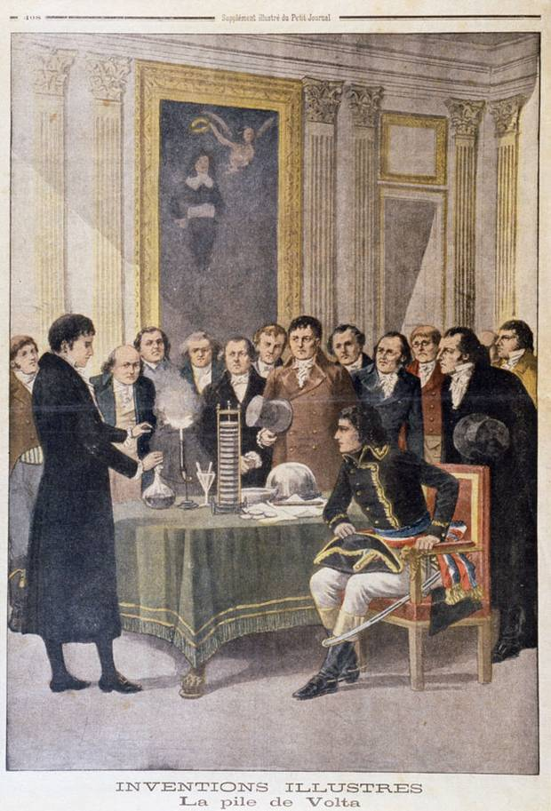
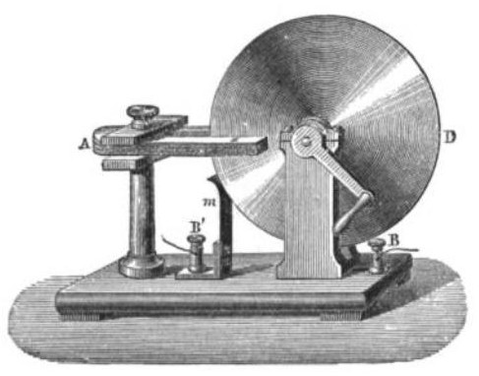
History of the discovery of electricity
1800 – Alessandro Volta invents the first electric battery. He also proved that electricity could travel over wires.
1821 – Faraday invents the first electric motor
1882 – Edison invents the light bulb
1883 – Transformer invented
1888 - Tesla Invents Alternating Current Motor for Westinghouse

Slide 4
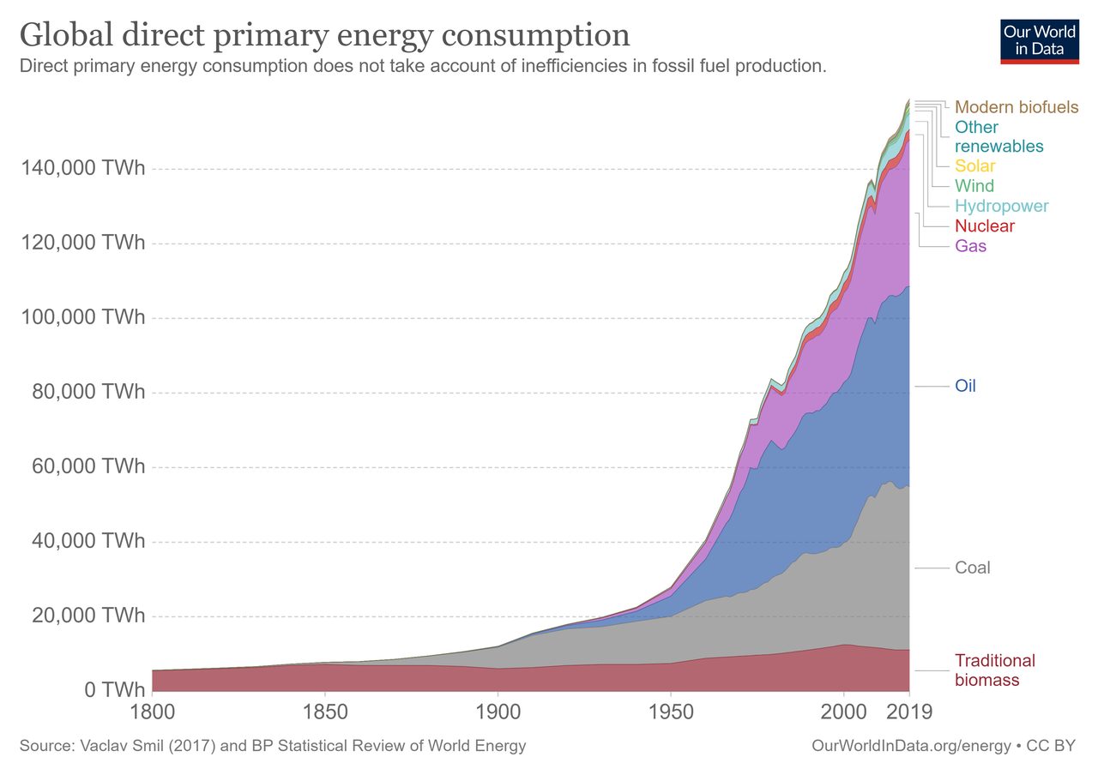
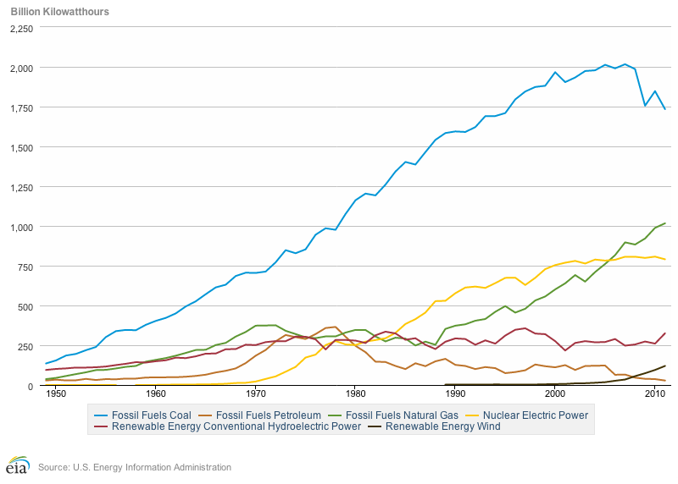
Global/US Energy Production

Slide 5
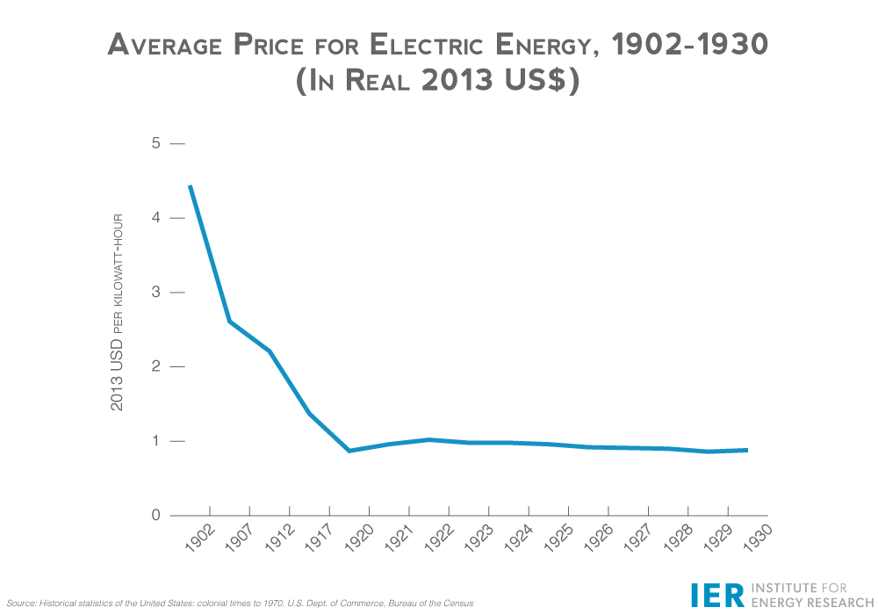
Electricity as a Commodity
Notes:
Economies of Scale

Slide 6
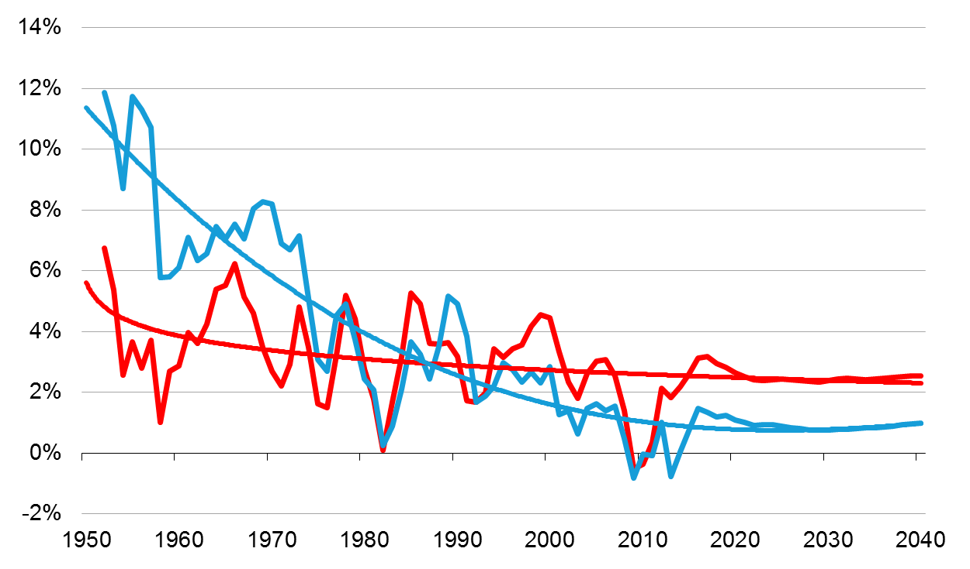
Electricity demand: growth in electricity use slows, but still increases by 28% from 2012 to 2040
percent growth (3-year compounded annual growth rate)
2011
History
Projections
Electricity Use
2011 – 2040
average
GDP
2.4%
0.9%
Source: EIA, Annual Energy Outlook 2013
Notes:
Decoupling of GDP & Energy

Slide 7
Types of Entities
Investor Owned Utility (IOU)
Municipality – Muni
Public Power
Cooperative – Co-ops
Merchant Plant
Regional Transmission Organization – RTO
Independent System Operator - ISO

Slide 8
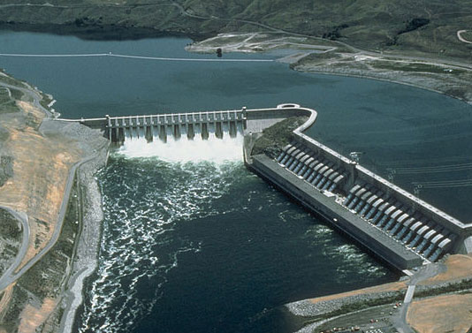
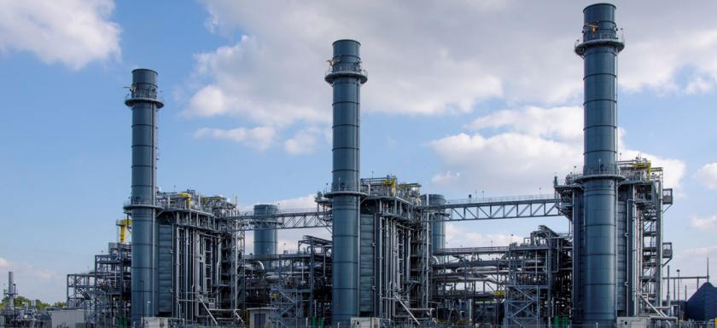

Sources of Electricity
Thermal (Coal/Natural Gas/Oil/Biomass)
Geothermal
Nuclear
Hydroelectric (Pump Storage/Tidal)
Solar (PV/Concentrated Solar Power)
Wind

Slide 9
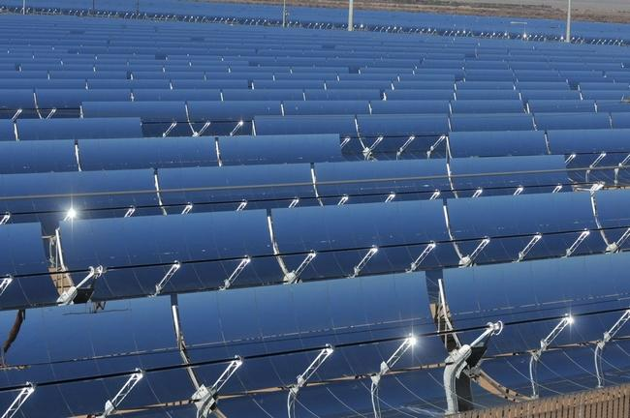
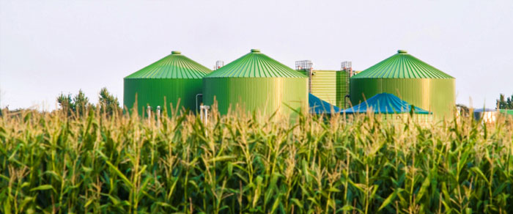
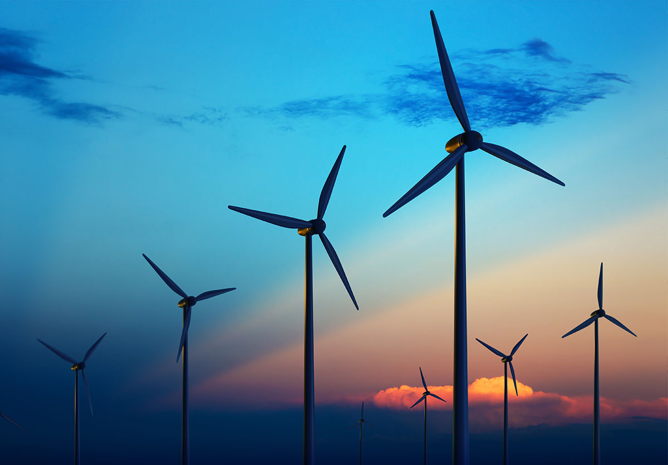
Renewables
Hydro
Solar
Wind
Biomass
Geothermal

Slide 10
Electricity generation from natural gas and renewables increases as a result of lower natural gas prices and declining costs of solar and wind renewable capacity, making these fuels increasingly competitive

Slide 11
U.S. energy production grows significantly, but consumption grows moderately under the AEO2020 Reference case assumption of current laws and regulations
other renewable energy

Slide 12
Additions to electricity generation capacity, 1985-2040
U.S. electricity generation capacity additions
gigawatts
Source: EIA Form 860 & EIA, Annual Energy Outlook 2013

Slide 13
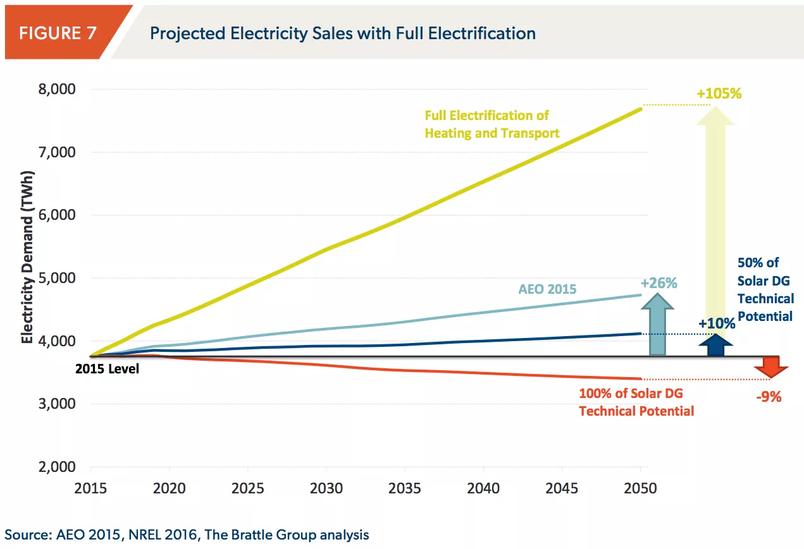
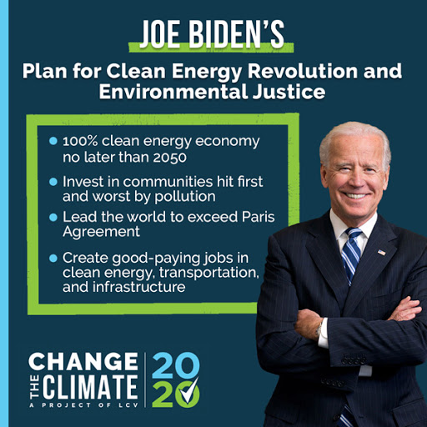
Electrification of Everything
Flat or Declining Load Growth
Electric Vehicles
Climate Change
RPS
California
ESG
Biden Clean Energy Initiative
Notes:
CA moving away from Gas and Internal Combustion Engines

Slide 14
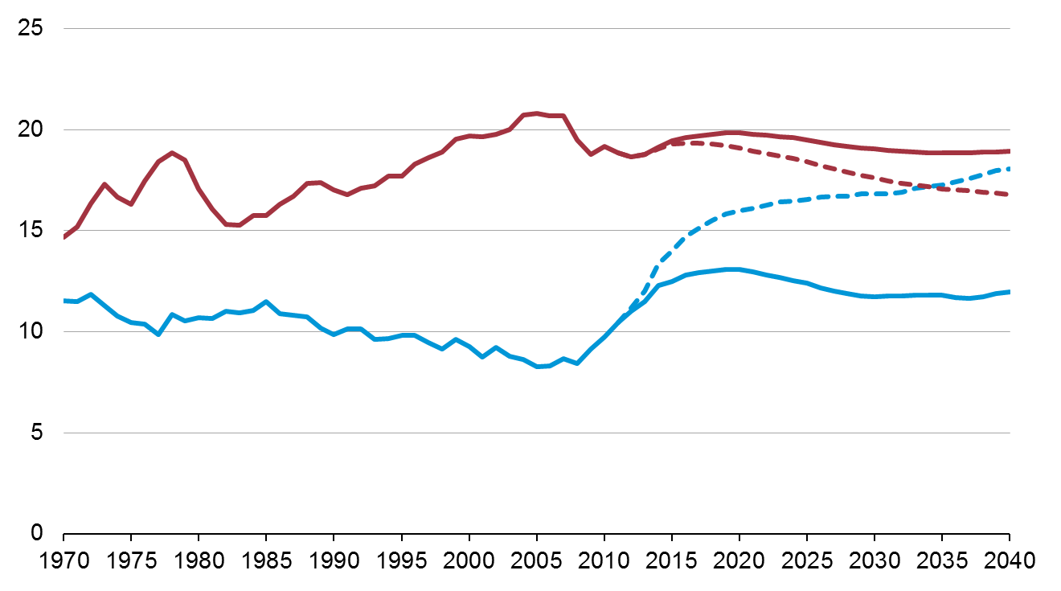
U.S. dependence on imported liquids depends on both supply and demand
U.S. liquid fuel supply
million barrels per day
History
Projections
2012
2014
32% STEO forecast for 2014
-8%
Consumption
37%
Net imports
40%
Petroleum Exports
Domestic supply
Source: EIA, Annual Energy Outlook 2013 and Short-Term Energy Outlook, April 2013

Slide 15
The United States becomes a net energy exporter on an annual basis by 2020 in the AEO2020 Reference case—

Slide 16
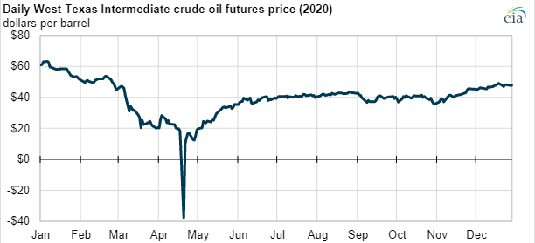
Crude Oil
Fuel/Heating Oil
Fracking
Storage/Pipelines
Downward Demand/Pricing Pressure
  Telework
  Electric Vehicles
  Economic Lag (Travel)
  Alternative Fuels/Biodiesel
Long Term Forecast @ $45/Barrel
Notes:
California has banned the sale of new gasoline cars by 2035
This is Pre-Covid

Slide 17
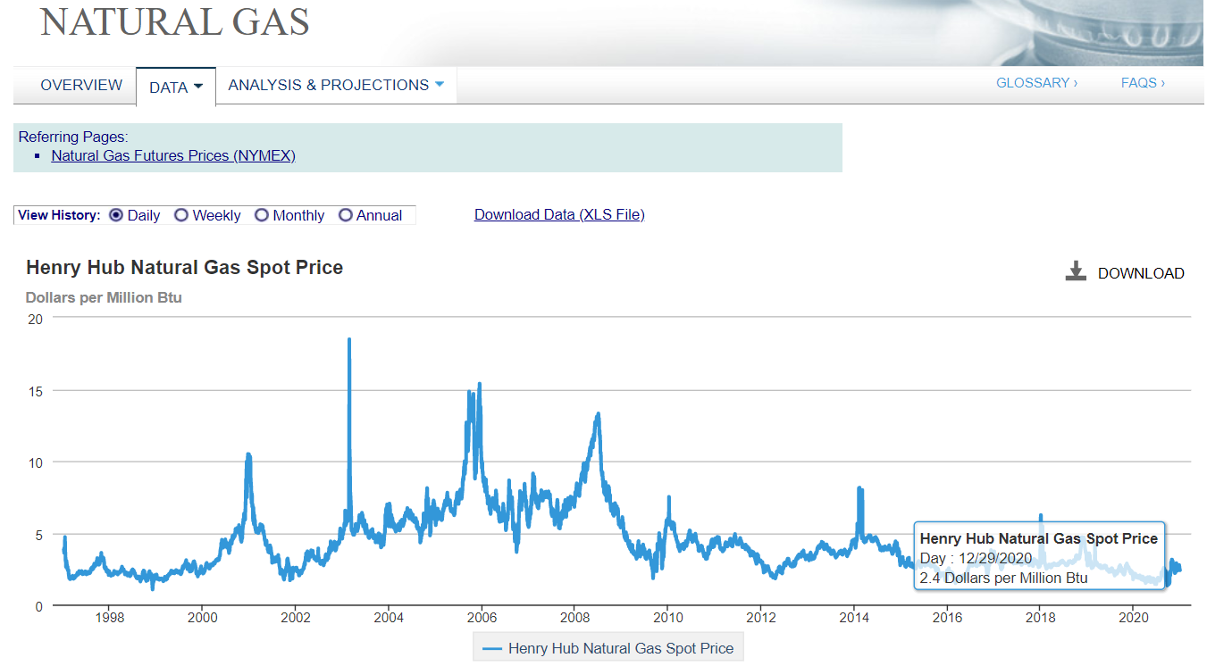
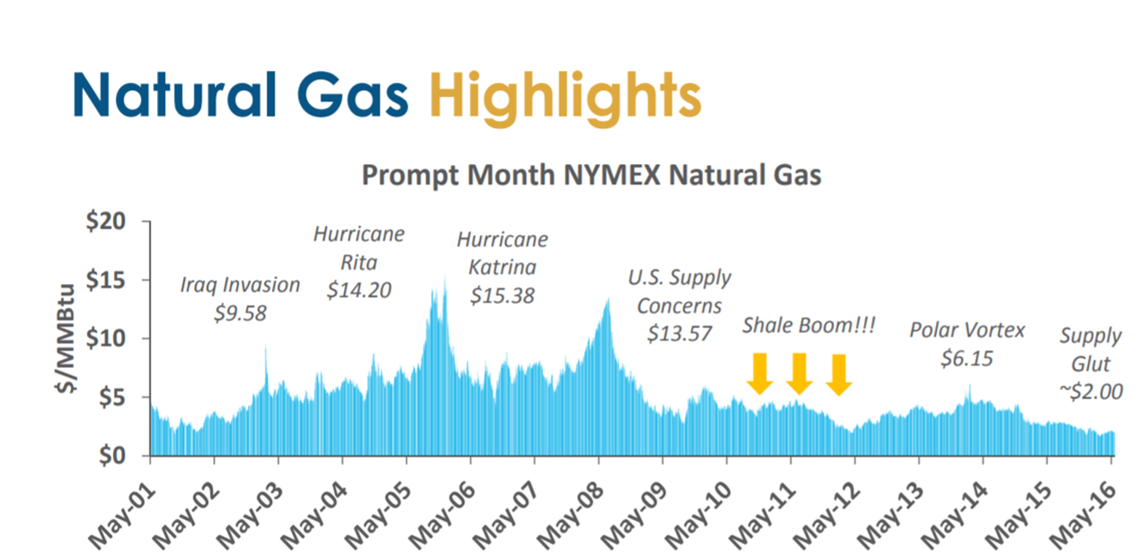
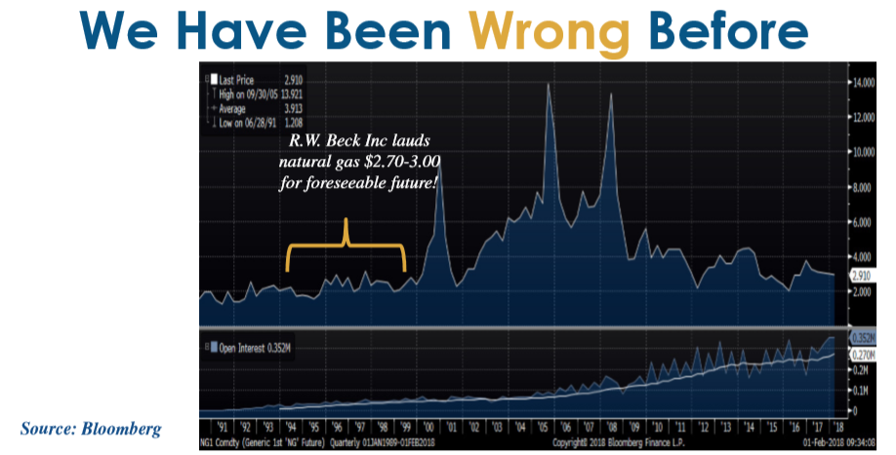
Natural Gas
Byproduct of Crude Oil/Fracking
Storage/Pipelines
United States Net Exporter
Supply Linked to Crude Oil
Mixed Demand/Pricing Pressure
  Electrification of Everything
  Environmental Pressures
  LNG Exports
  Hydrogen Mixing/Replacement

Slide 18
Storage
Increasing Demand to Integrate Renewables
Falling Prices
Limited Rare Earth Metals
Compressed Air
Hydrogen
Pumped Storage

Slide 19
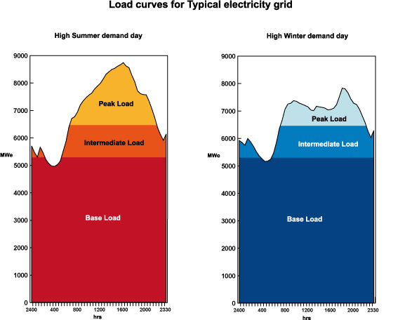

Slide 20
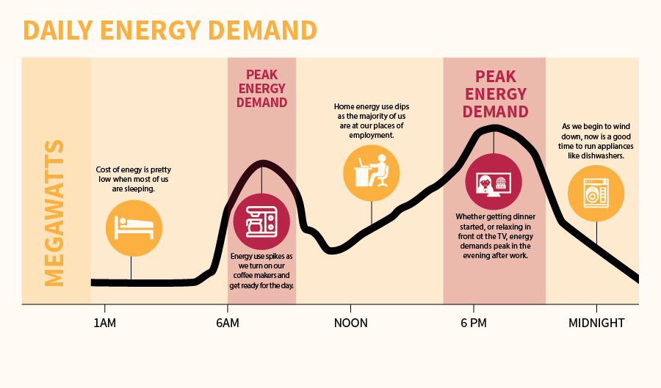
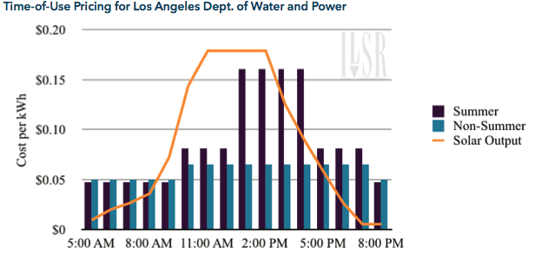
Time of Use
Peak Load has Shifted from Night to Afternoon
Returning to Night
Notes:
When used for Electricity, at night
When used for Cooling, 4 PM

Slide 21
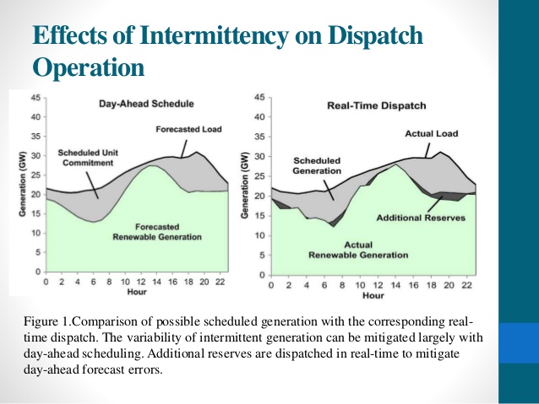
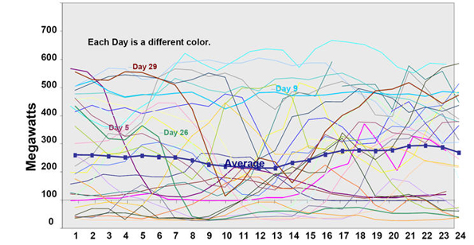
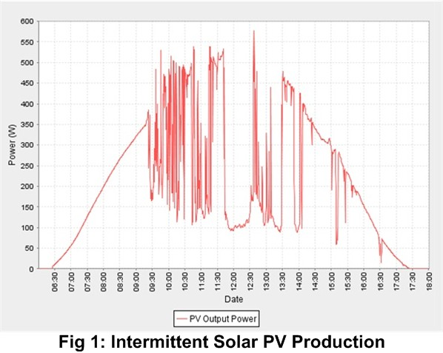
Renewable intermittency

Slide 22
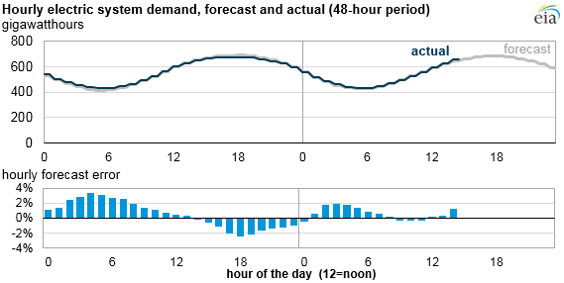
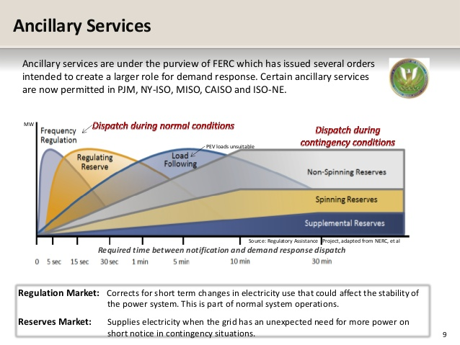
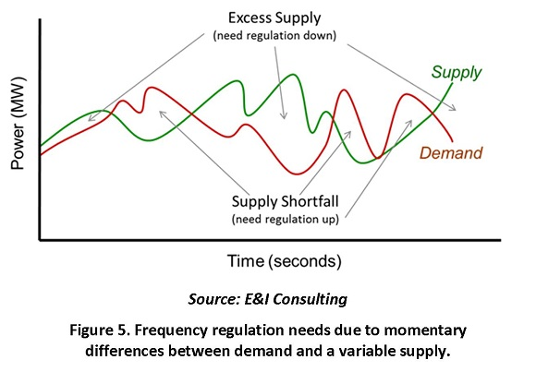
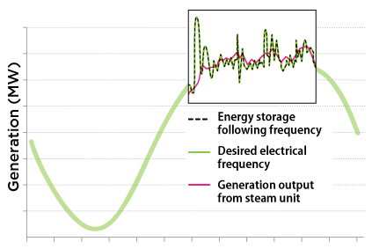
Ancillary Services
Regulation
Ramping
Reserves

Slide 23
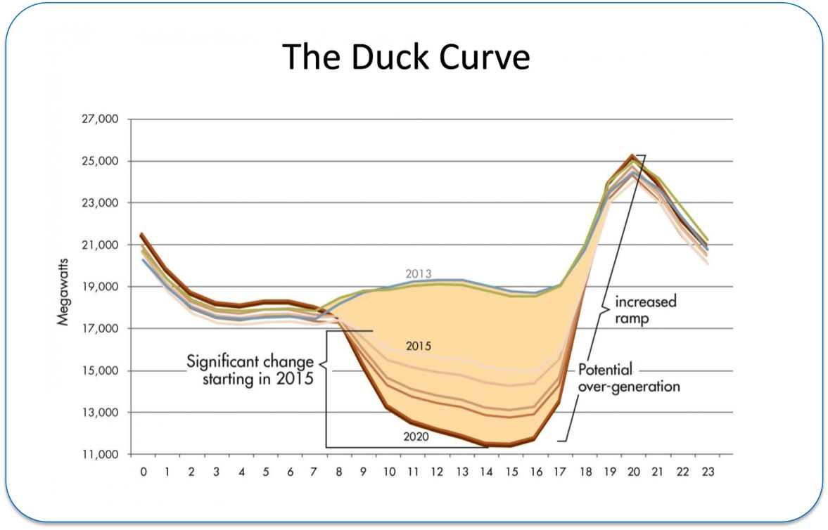
Notes:
17 MW Ramp in CA in 2021

Slide 24
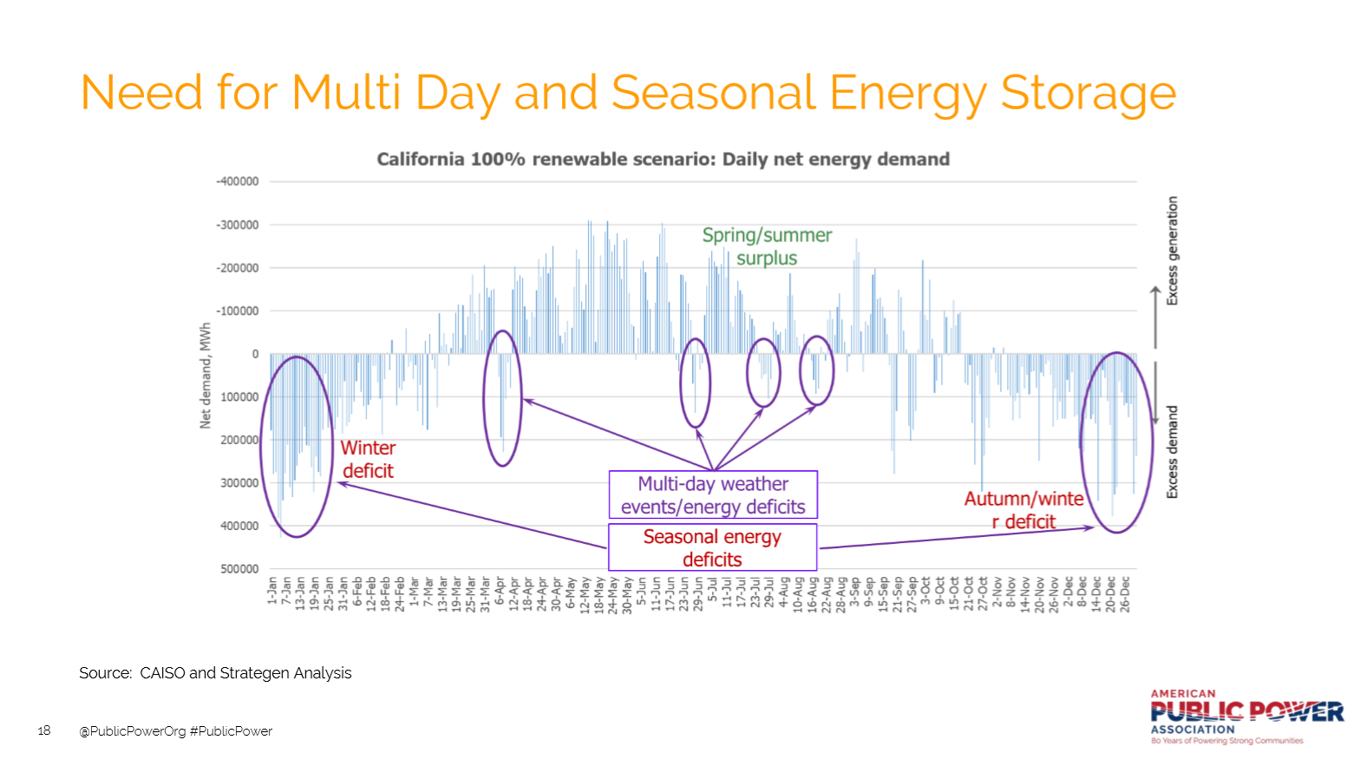

Slide 25








Alternative and electric vehicles gain market share in the AEO2020 Reference case—

Slide 26
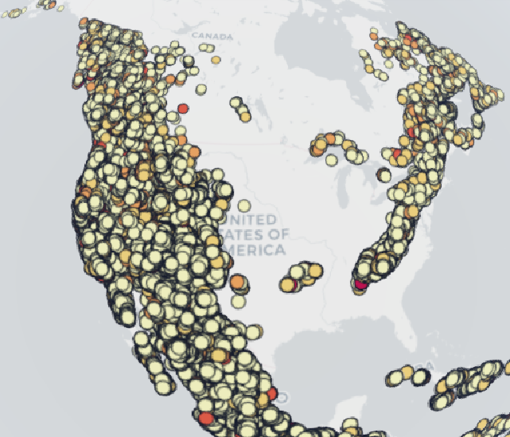
Pump Storage
Makes up 95%+ of all Current Energy Storage Capacity
600K Sites with 23K TWh of Storage in World
20K Sites with 50 GWh of Storage in US
Recent Project Provided 0-150 MW in 60 Seconds
Australian Renewable Energy Mapping Infrastructure

Slide 27
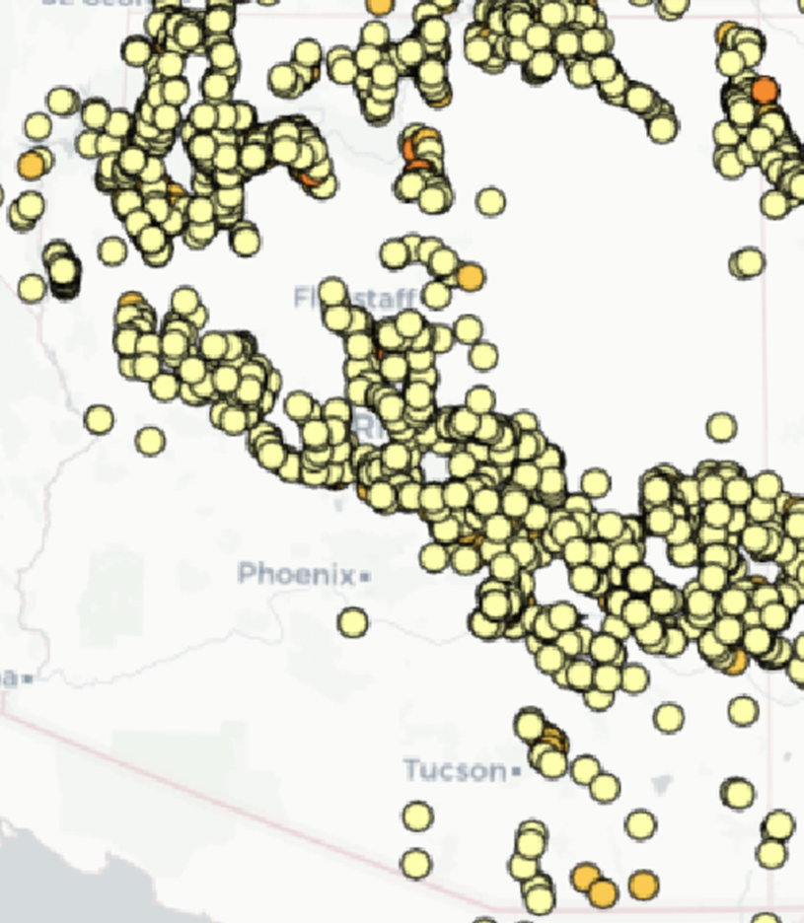
Pumped Storage in Arizona https://nationalmap.gov.au/renewables/
2 GWh – 6 Hr
150 GWh – 18 Hr

Slide 28
Population and residential housing stocks continue to grow mostly in the South and West between 2019 and 2050
Census divisions
New
England
Mountain
West
North
Central
East
North
Central
Mid-Atlantic
West
South
Central
East
South
Central
Pacific
South
Atlantic

Slide 29
As a result of population shifts, overall U.S. heating needs decrease and cooling needs increase—

Slide 30
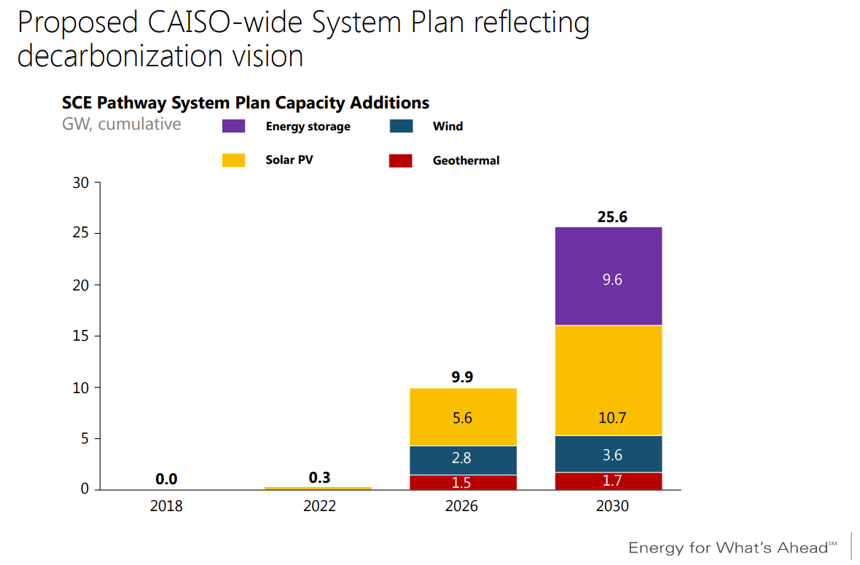

Markets
Arizona in the Crosshairs
Nagging Neighbor
Notes:
5,000 MW Short for Resource Adequacy
NW & AZ seeing Shortages as well

Slide 31
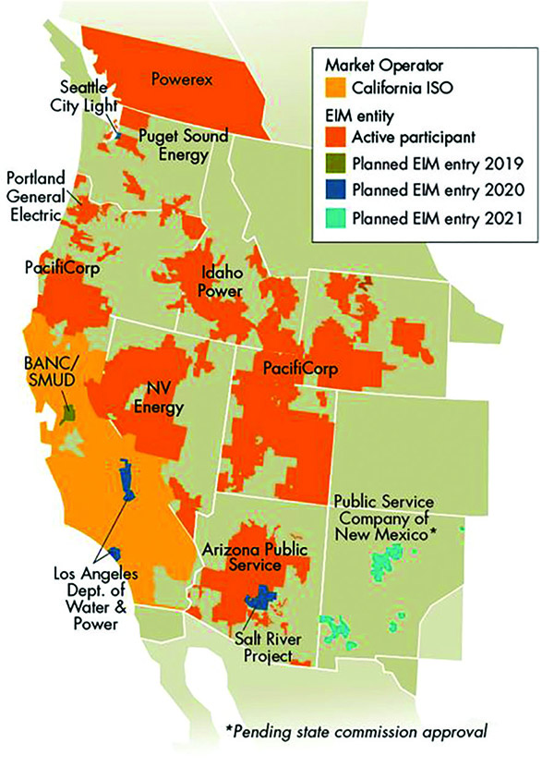
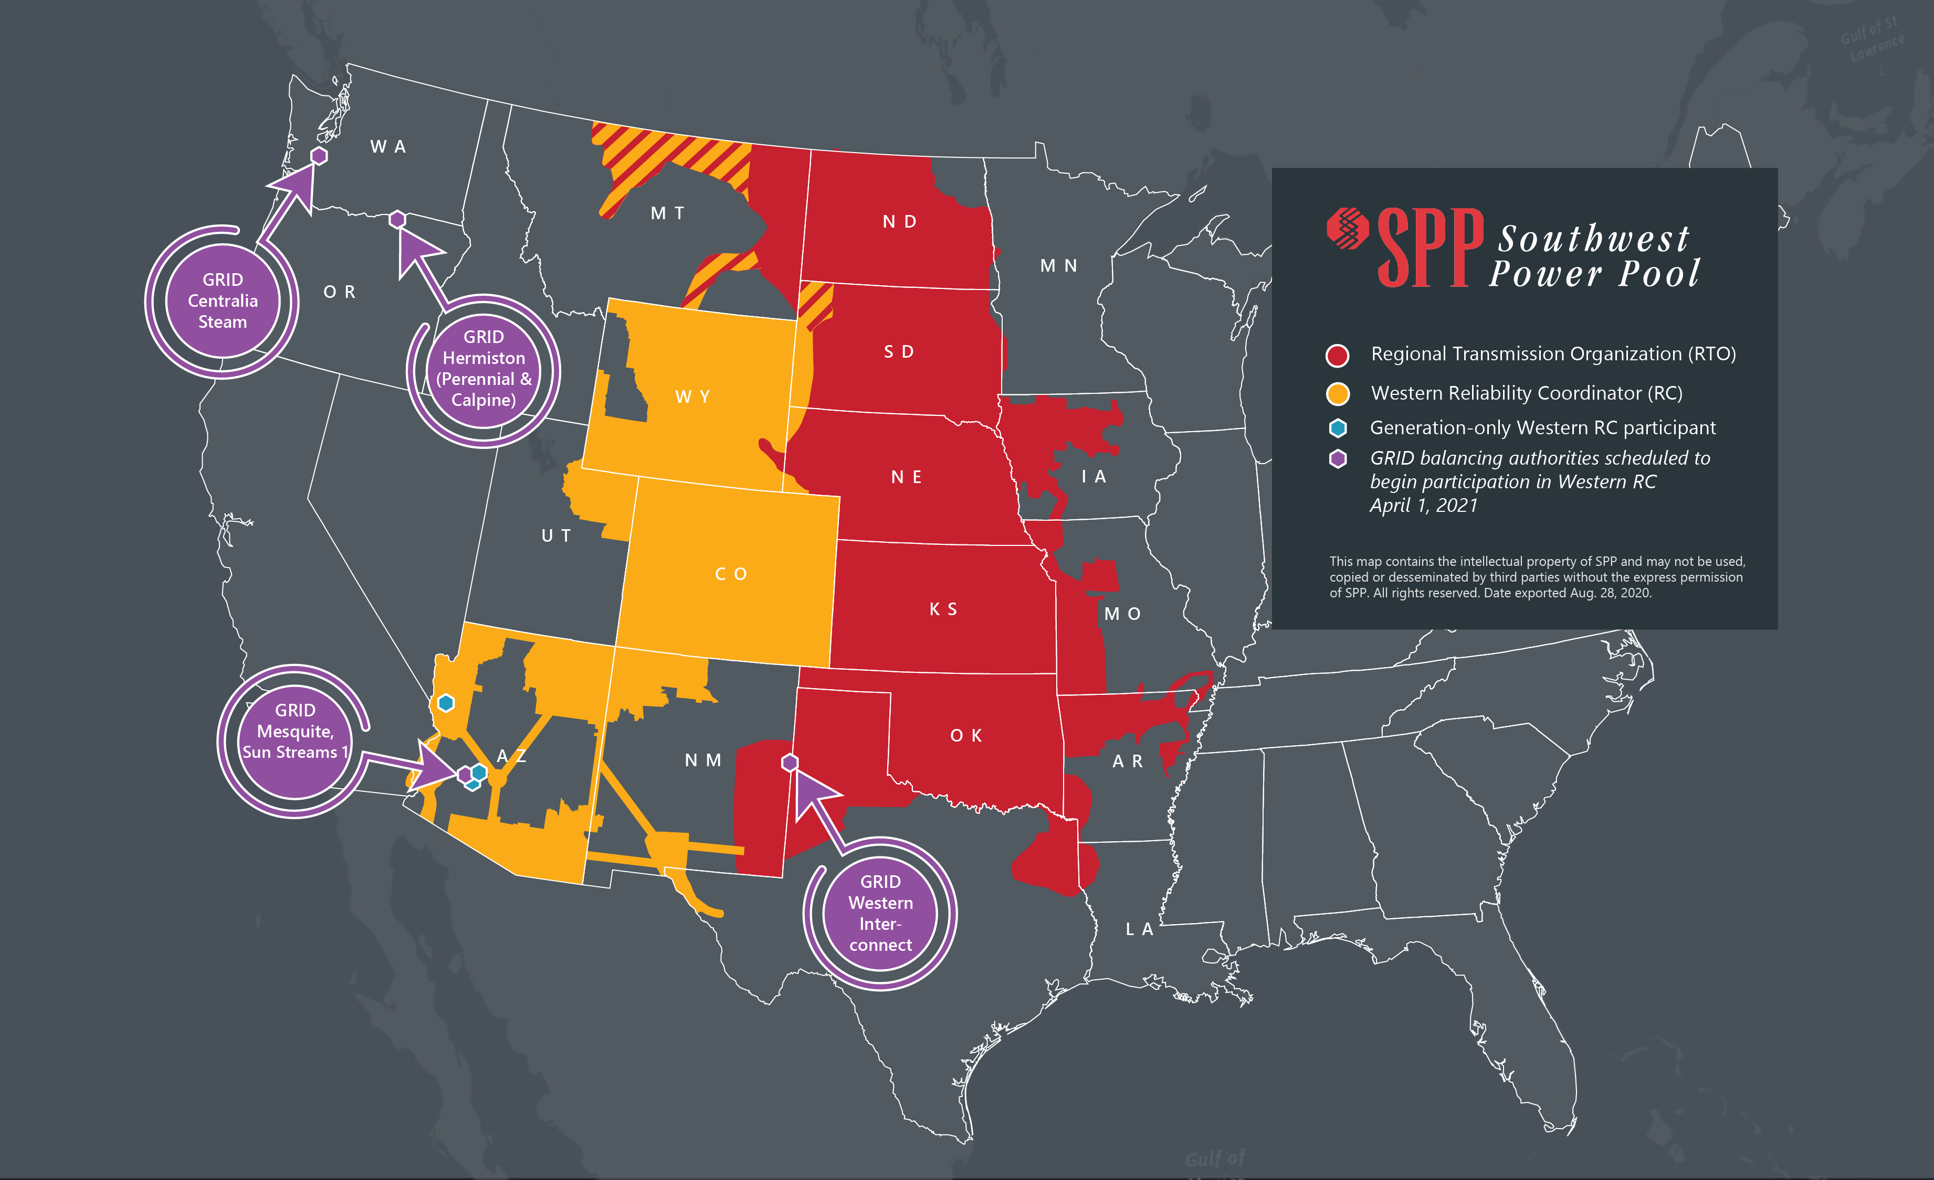
Market Mania

Slide 32
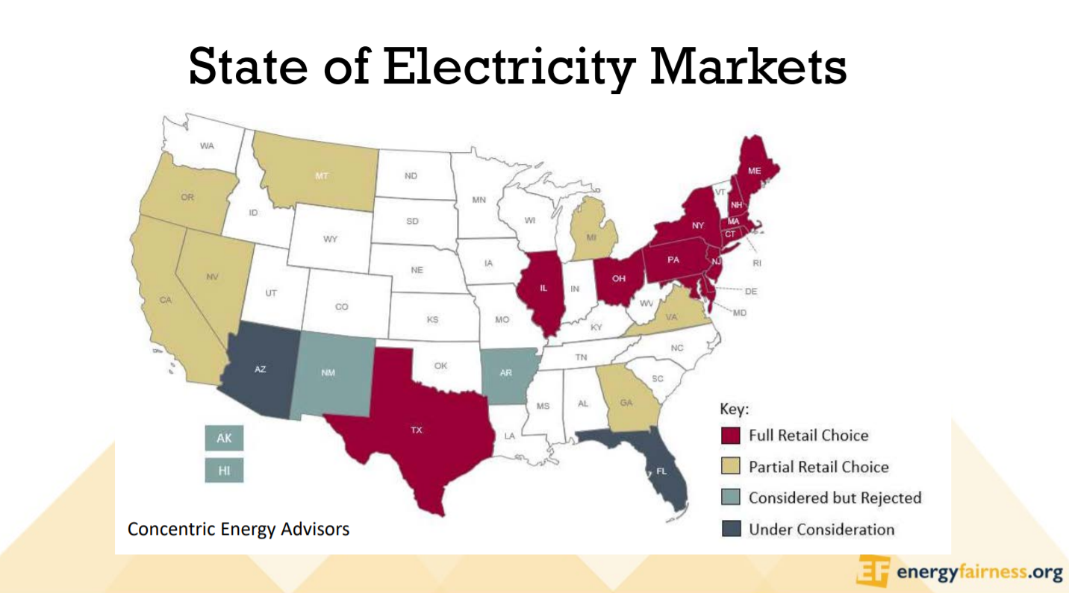

Slide 33
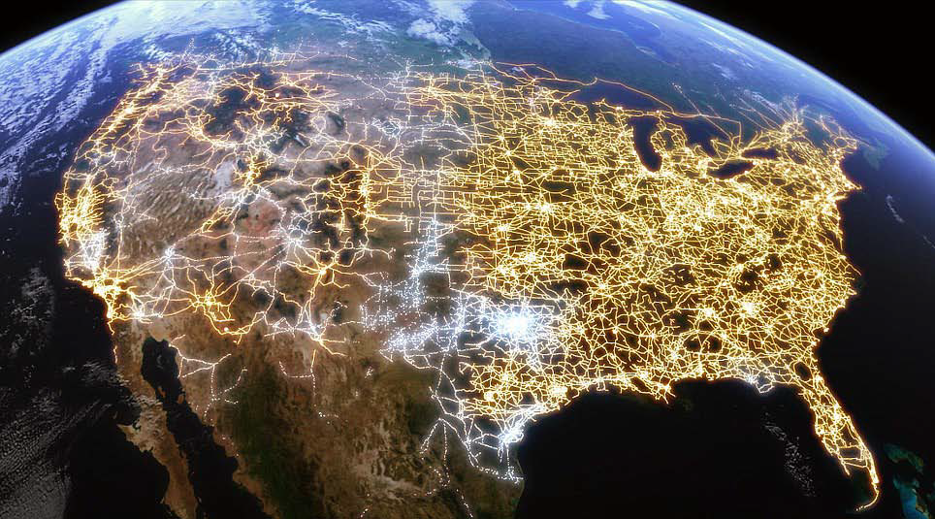
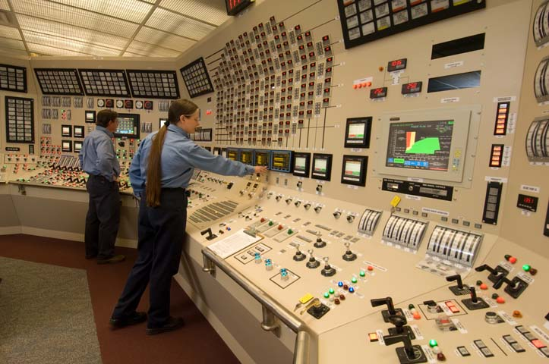
Transmission lines
Transmission Lines
  69 kV
  115 kV
  230 kV
  500 kV
  765 kV

Slide 35
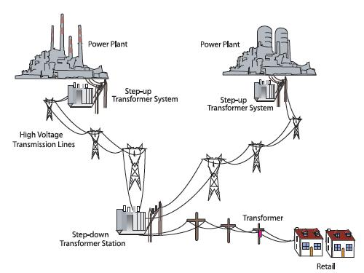
Western Interconnect

Slide 36
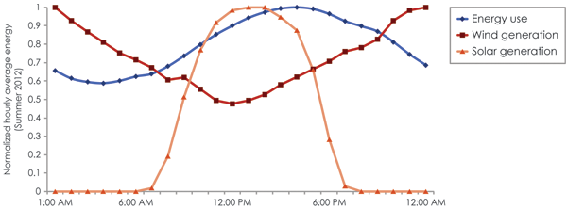
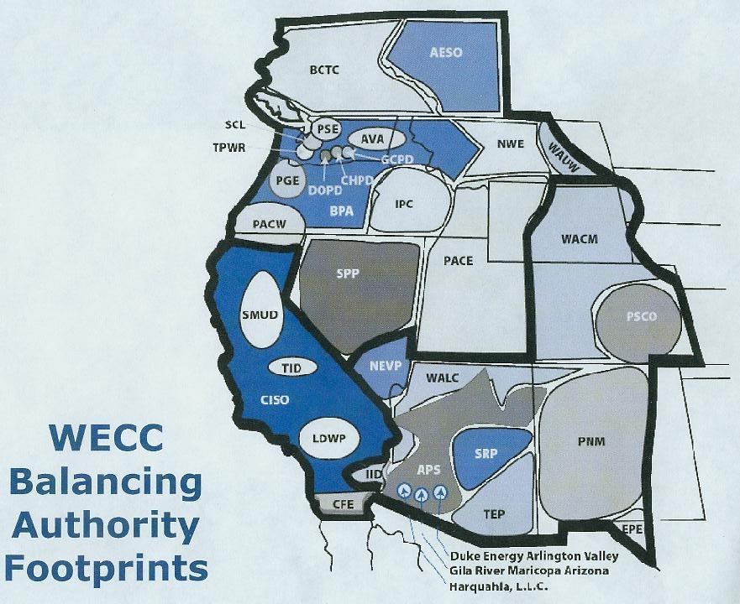
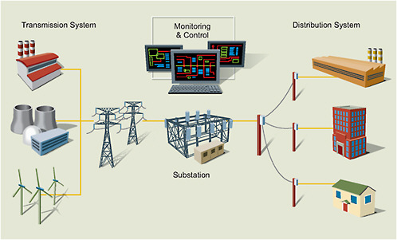
Balancing Authority

Slide 37
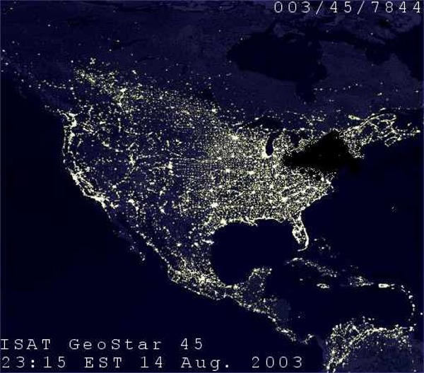

Slide 38
AEO2020 Reference case electricity prices fall slightly; declining generation costs are offset by rising transmission and distribution costs

Slide 39
An increasing share of total electricity demand is met with customer-owned generation, including rooftop solar photovoltaic

Slide 40
Coal
Dead in the United States
Morgan Stanley Predicts Complete Exodus from US Portfolio by 2033
Exports to China & others
Focus Now on Natural Gas
Notes:
Lower natural gas prices throughout the AEO2020 projection period accelerate nuclear capacity retirements—

Slide 41
Nuclear
Carbon Free Base Load Resource
Increased Interest Due to SMR
Fukushima
More Expensive than Natural Gas Plants
Huge Capital Costs
Waste Disposal/Yucca Mountain
Notes:
Lower natural gas prices throughout the AEO2020 projection period accelerate nuclear capacity retirements—

Slide 42
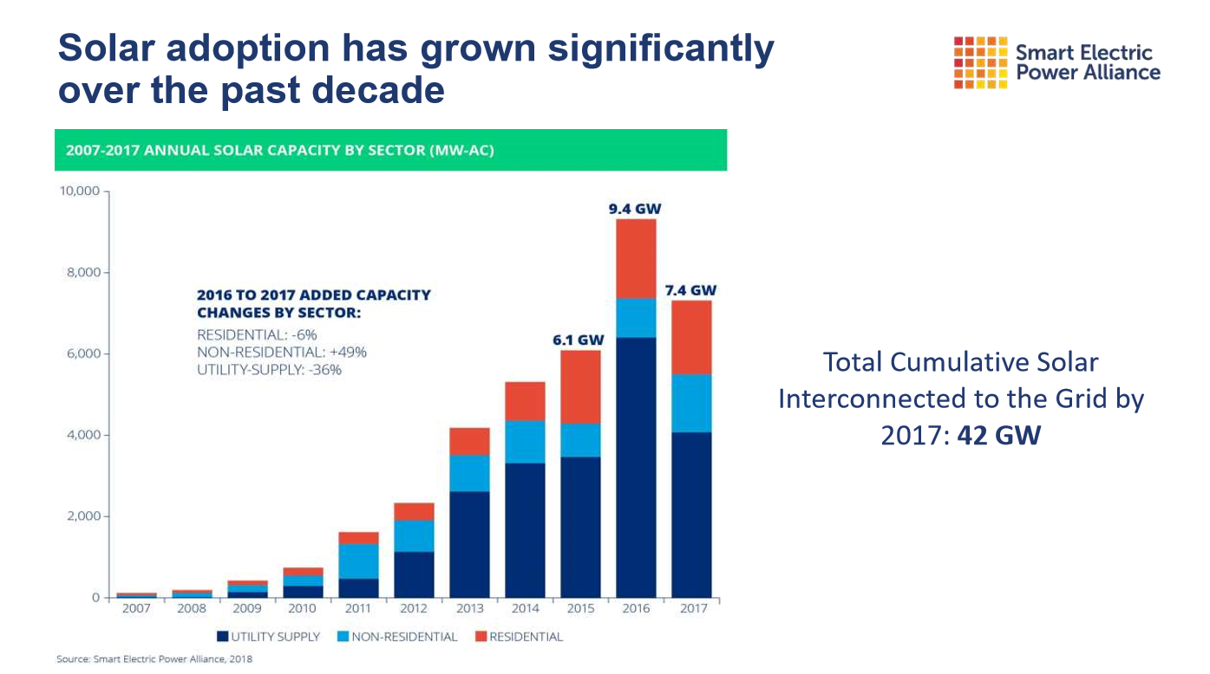
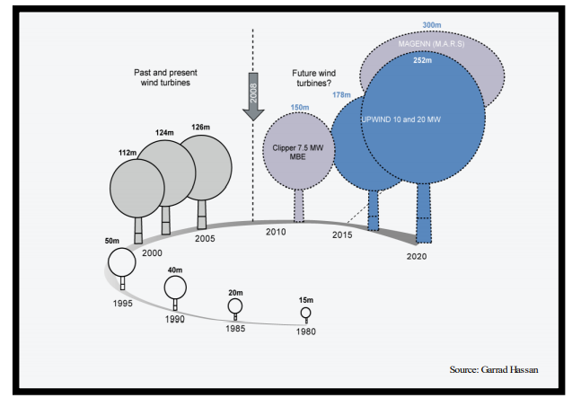
Solar/Wind
Location Dependent
Tax Incentives/Credits
ESG
Corporation Initiatives

Slide 43
Hydroelectric
Federal MOU
Environmental Kumbaya
WAPA - “Value of Hydropower”
Hinting at Market Participation
ACC & Others RPS Rules
Integration of Renewables
Pump Storage

Slide 44
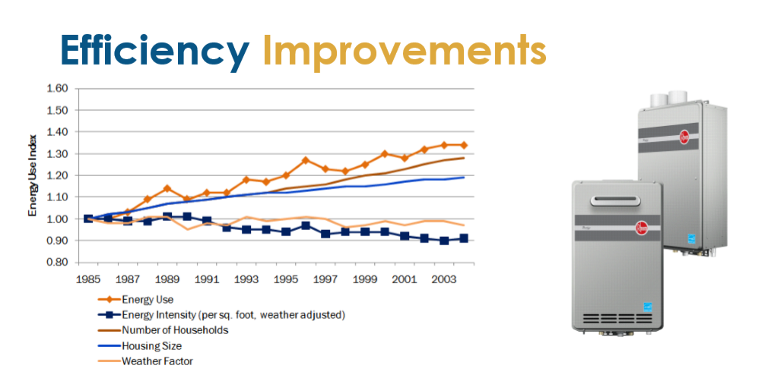
Future Needs
Transmission/EV Infrastructure
Storage
Energy Efficiency Technology

